Slide 1
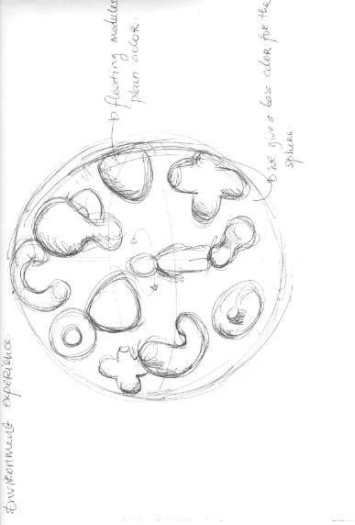
“Welcome to Fantasy Float!”Create your own perfect floaties World!”
Environment experience :
A sphere with floating plain objects
We create a base color for the sphere ( let’s set a mood board for this )

Slide 2
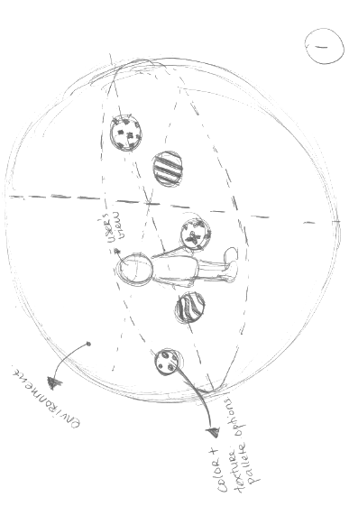
Interaction :
Color Bubbles pop up to user’s view with pointer
Text Guide :
Simply point your select color to a floaty and see your floaty comes alive
We can add fun music background
User action scenario :
Select one palette and point to one object
Object will transform to palette texture with a bubbly sound and a bit bouncy movement
To change object color and texture simply select a palette and drag to object
Once user finish coloring all floaties, we’ll give them congratulations message/music/reward

Slide 3
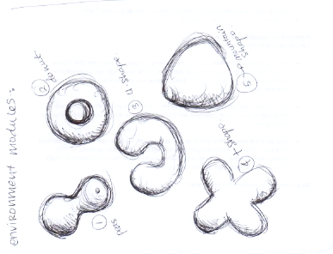
Floaties Object modules
Let’s have 5 module shapes
We can put 3 of each shapes with different scales ( Small, Medium, Large )
Scatter 15 modules floating around sphere environment

Slide 4
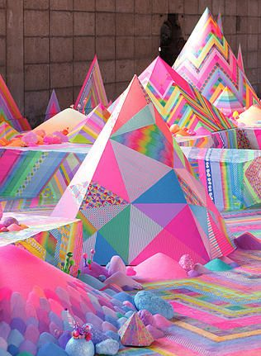
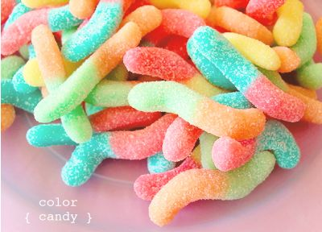
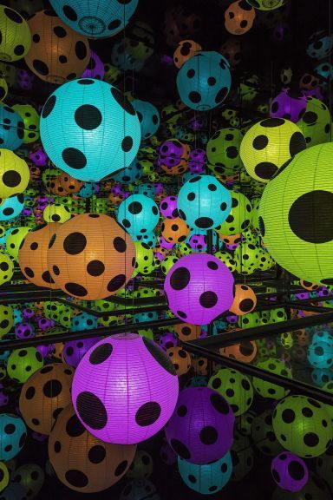
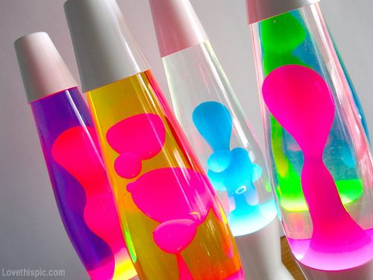
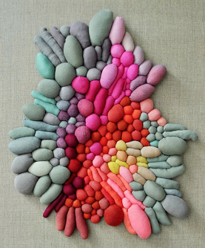
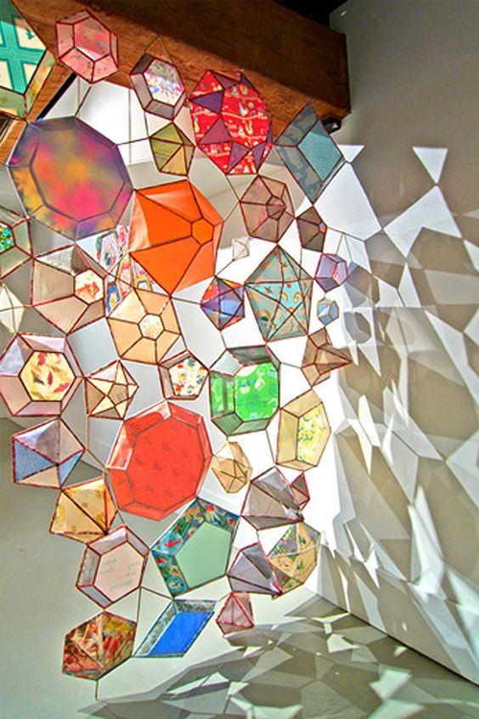
Mood Board

Slide 5
